Slide 1
An AI for Nash’s Hex
Jonathan Zhou and Cadence Weddle

Slide 2
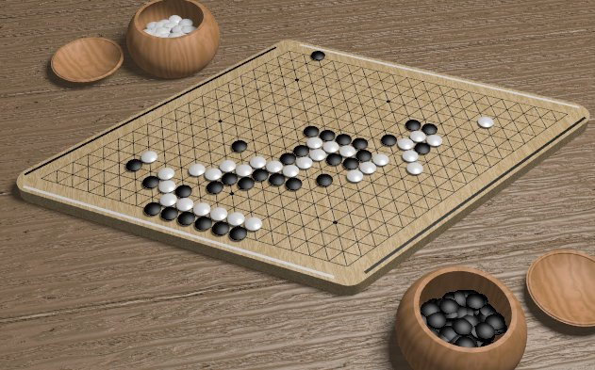
The Game of Hex

Slide 3
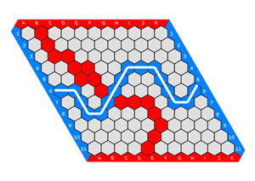
Rules of the Game of Hex
Each player get’s a color
  In this case it’s Red and Blue
Players take turns placing a stone(coloring in) of their color on a single cell within the overall playing board (The stone cannot be placed on top of another player’s stone).
The goal for each player is to form a connected path of their own stones linking the opposing sides of the board marked by their colors, before their opponent connects his or her sides in a similar fashion.
The first player to complete his or her connection wins the game.
The four corner hexagons each belong to both adjacent sides.

Slide 4
History of the Game of Hex

Slide 5
Strategy of the Game of Hex

Slide 6
Artificial Intelligence

Slide 7
Technologies used

Slide 8
What is Artificial Intelligence

Slide 9
Monte Carlo Tree Search

Slide 10
The Deep Neural Network

Slide 11
Iterative Optimization

